Slide 1
Research Plan: The Transmission Expansion Planning Problem under the zero-carbon emission context
Erik F. Alvarez
Supervisors: Dr. Andrés Ramos Galán and Dr. Luis Olmos Camacho

Slide 2
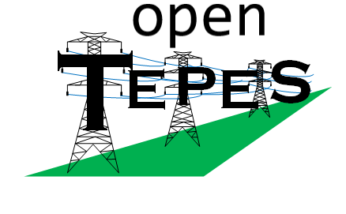


Reduction techniques of the problem size
Transmission grid modelling
Temporal reduction
Representative stage (periods) with chronological interdependency
Search-space reduction
Portfolio projects (decision variable clustering) based on game theory
AC-OPF within the TEP problem
An improved linear AC-OPF model
Based on the branch flow model
A SOCP AC-OPF model
Based on the Line-Wise model
It allows us:
Investment in Reactive power compensation
To verify the accuracy and feasibility of the solution obtained
Central and Local Flexibility
Model
Central flexibility
Management of hydro reservoirs, PSH, batteries, etc.
Local flexibility
Demand-side management
Bi-level model considering distribution grid and microgrids as well as local flexibility schemes.
Multi-stage transmission expansion planning
Hourly resolution
Storage management and investment

Slide 3
Temporal reduction
What data to use for it?
Ex-ante or ex-post?
correlations?
Clustering
Heuristic
Optimization
Relation between periods
Transition matrices
Robustness of the clustering
Multiple Scenarios
Multiple periods
Stability of the representative periods
Stochastic multi-period transmission expansion planning with suitable representative periods

Slide 4
Joint Research Work:
Introducing Learning Algorithms within an Operational State Aggregation Method for Power System Planning

Slide 5
Problem Definition
To solve our problems:
Kristof: GEP with Representative Areas (Geographical aggregation considering weather area)
Erik: TEP with Representative Weeks of 24 hours
Considering AC-OPF (4-6 times of the TEP with DC-OPF)
*ESOM: Energy System Optimization Model
*GEP: Generation & Storage Expansion Planning
*TEP: Transmission Expansion Planning
*TSA: Time Series Aggregation

Slide 6
State-of-the-art
The main feature of the paper:
[1], is related to compare TSA methods and GEP formulations which allow for long-term storage for the first time in an investment setting.
[3], is related to the unification of methods by Hilbers et al. and Teichgraeber et al.– which use operational variables in models without storage – with that of Kotzur et al.– which allow chronology-preserving aggregation for storage technologies.
[6], is related to the unification of the a priori and posteriori schemes.
[7], is related to consider the a posteriori scheme which uses the operation and investment cost.
Gaps:
A posteriori scheme or ex-port or Cost/Benefit oriented approach
Ordering and inter-periods links
Years data
Dynamic planning
Stochastic
*ESOM: Energy System Optimization Model
*GEP: Generation & Storage Expansion Planning
*TEP: Transmission Expansion Planning
*TSA: Time Series Aggregation
Notes:
[1] Gonzato, Sebastian, Kenneth Bruninx, and Erik Delarue. "Long term storage in generation expansion planning models with a reduced temporal scope." Applied Energy 298 (2021): 117168.
[2] Pfenninger, Stefan. "Dealing with multiple decades of hourly wind and PV time series in energy models: A comparison of methods to reduce time resolution and the planning implications of inter-annual variability." Applied energy 197 (2017): 1-13.
[3] Hilbers, Adriaan P., David J. Brayshaw, and Axel Gandy. "Reducing climate risk in energy system planning: a posteriori time series aggregation for models with storage." Applied Energy 334 (2023): 120624.
[4] Kittel, Martin, Hannes Hobbie, and Constantin Dierstein. "Temporal aggregation of time series to identify typical hourly electricity system states: A systematic assessment of relevant cluster algorithms." Energy 247 (2022): 123458.
[5] Merrick, James H., John ET Bistline, and Geoffrey J. Blanford. "On representation of energy storage in electricity planning models." arXiv preprint arXiv:2105.03707 (2021).
[6] Zhang, Yuheng, et al. "A Model-Adaptive Clustering-Based Time Aggregation Method for Low-Carbon Energy System Optimization." IEEE Transactions on Sustainable Energy 14.1 (2022): 55-64.
[7] Sun, Mingyang, et al. "Data-driven representative day selection for investment decisions: A cost-oriented approach." IEEE Transactions on Power Systems 34.4 (2019): 2925-2936.
[8] Fazlollahi, Samira, et al. "Multi-objectives, multi-period optimization of district energy systems: I. Selection of typical operating periods." Computers & Chemical Engineering 65 (2014): 54-66.

Slide 7
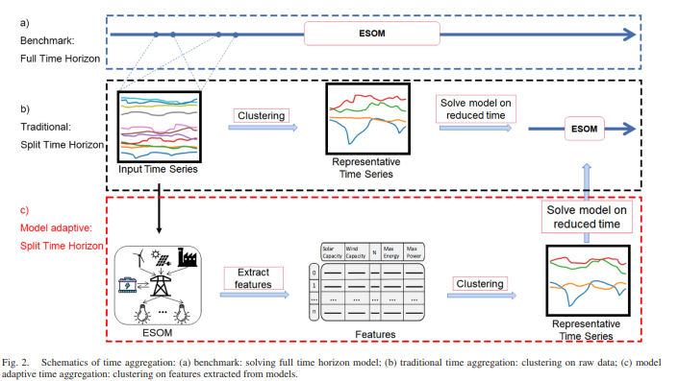
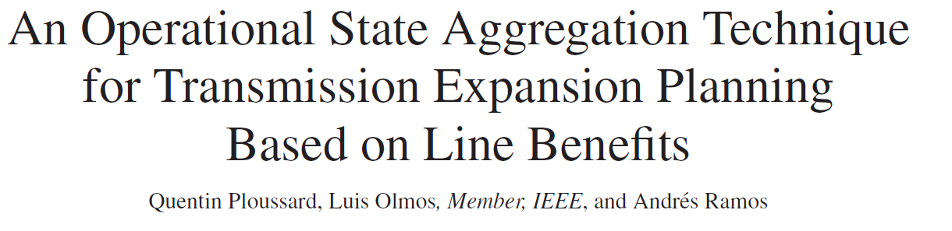
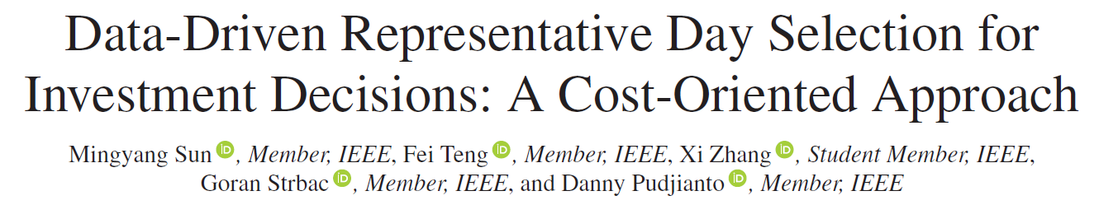
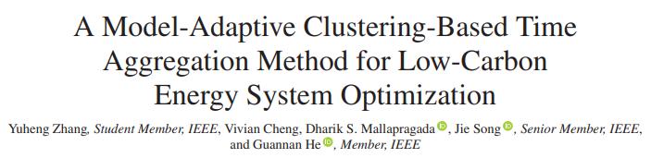
2017
2019
2023

Slide 8
Keys & Gaps
Keys:
Do we need to perform the problem size reduction? Yes! about 35 times more efficient – according to Ploussard, Q., et al.
Ex-ante or ex-post? Ex-post! We got rich data from models
Time consumption of the method? 60 min without considering the execution of the relaxed model and only 24 nodes!
Thus, We:
Use of representative days/hours/weeks or non-homogenous sets of hours/days to reduce computational complexity of planning models
For the selection of these representatives, clustering is usually performed over a large set of multi-dimensional input data.
Use a relaxed version of the planning model (i.e., TEP with continuous variables) in the “a posteriori” scheme
The relaxed version is usually executed per hour, day, or week but also for all the year in a deterministic planning approach.
Problems & Gaps:
Considering a huge amounts of weather data, solving the relaxed model for all possible input days might still be computationally demanding
Using a learning algorithm to approximate the outputs of the relaxed model
Accuracy
Scalability

Slide 9
Gaps
From Literature:
Do we need to perform the problem size reduction? Yes! about 35 times more efficient – according to Ploussard, Q., et al.
Ex-ante or ex-post? Ex-post! We got rich data from models
Time consumption of the method? 60 min without considering the execution of the relaxed model and only 24 nodes!
Thus, We:
Use of representative days/hours/weeks or non-homogenous sets of hours/days to reduce computational complexity of planning models
For the selection of these representatives, clustering is usually performed over a large set of multi-dimensional input data.
Use a relaxed version of the planning model (i.e., TEP with continuous variables) in the “a posteriori” scheme
The relaxed version is usually executed per hour, day, or week but also for all the year in a deterministic planning approach.
Problems & Gaps:
Considering a huge amounts of weather data, solving the relaxed model for all possible input days might still be computationally demanding
Using a learning algorithm to approximate the outputs of the relaxed model
Accuracy
Scalability

Slide 10
Summary
GAPS
From Literature:
Do we need to perform the problem size reduction?
Yes! about 35 times more efficient – according to Ploussard, Q., et al.
Ex-ante or ex-post?
Ex-post! We got rich data from models
Time consumption of the method?
60 min without considering the execution of the relaxed model and only 24 nodes!
Consider a huge amounts of weather data (scenarios or years)
Use of learning algorithms to replace part or all the process of the determination of representatives.
Increase accuracy and scalability

Slide 11
Proposal: Enhancing parts of the Operational State Aggregation Method using Learning Algorithms
Relaxed ESOM
Extract features
Clustering Method
Representative hours, days or system states
ESOM
Relaxed ESOM
Extract features
Clustering Method
Representative hours, days or system states
ESOM
Current proposal
Potential extension
Greedy ambition
Learning-assisted Optimization
*ESOM: Energy System Optimization Model
*GEP: Generation & Storage Expansion Planning
*TEP: Transmission Expansion Planning

Slide 12
Research Plan
Literature review:
Review of learning-assisted approaches
Review of learning-assisted power system optimization
Review of neural networks
Using Python and PyTorch (Ruben’s suggestion), steps:
First, install PyTorch. (You can follow the official PyTorch installation guide for this).
Once you have installed PyTorch, you can validate the installation by running a small program in PyTorch as a non-root user 1. This will ensure that PyTorch has been installed correctly.
After validating the installation of PyTorch, you can start using it for image classification . You can also learn about tensors, datasets and dataloaders, transforms, building models, automatic differentiation, optimization loop, saving/loading and using models from the official PyTorch tutorials.
Design my own IA-based method.

Slide 13
A Learning-Assisted Optimization Model for Power System Planning
Motivation
Traditional solvers are slow - fast approximate solvers needed
Method
Experiments
Application

